Slide 1
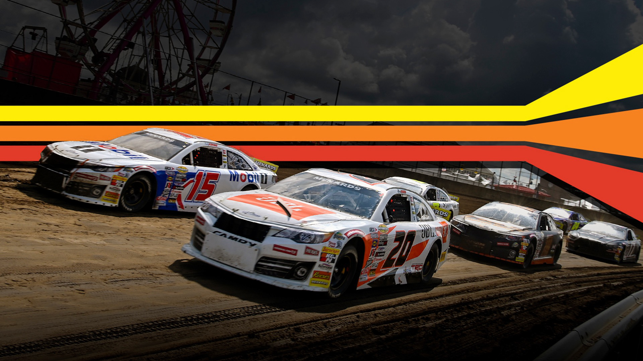



PR & MARKETING
SUMMIT 2023

Slide 2
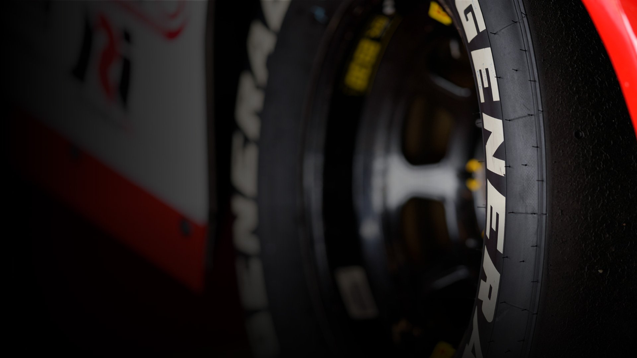
COMMUNICATIONS, DIGITAL, & BROADCAST STAFF​
CHARLES KRALL
Manager of Communications, ARCA Menards Series
RAY SMITH
Director, Racing Communications, NASCAR Communications
TADD HAISLOP
Manager, Digital Editorial, ARCARacing.com, NASCAR Digital Media
ADAM FENWICK
SR. Coordinator Digital Editorial, NASCAR Digital Media
BEN BAKER
Managing Director , Domestic Broadcasting, NASCAR
DAN BARKER
Managing Director, Direct to Consumer, NASCAR
JOE KELLY
Access & Production Coordinator, Library & Licensing, NASCAR

Slide 3
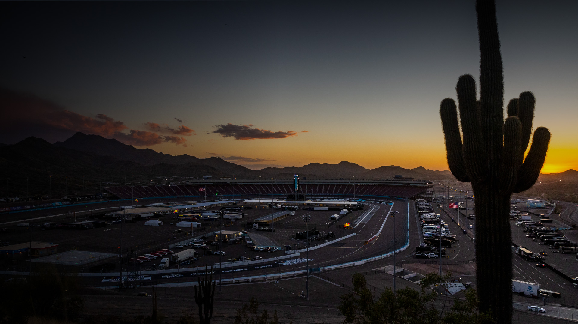
MARKETING STAFF
JESSE HARRIS
Managing Director of Partnerships and Business Operations, ARCA Menards Series
DAN STUART
Director, Partnership Marketing, ARCA Menards Series
BOB DUVALL
Senior Director of Business Development, NASCAR Event Management
LAURIE ROBINSON
Senior Manager of Analysis Partner Sales, NASCAR
JACOB STOTZ
Senior Manager, Marketing and Events, ARCA Menards Series
LAUREN WESCOAT
Director, Touring Series Racing Operations
RYAN MUSIALOWSKI
Senior Coordinator, Touring Series Racing Operations

Slide 4
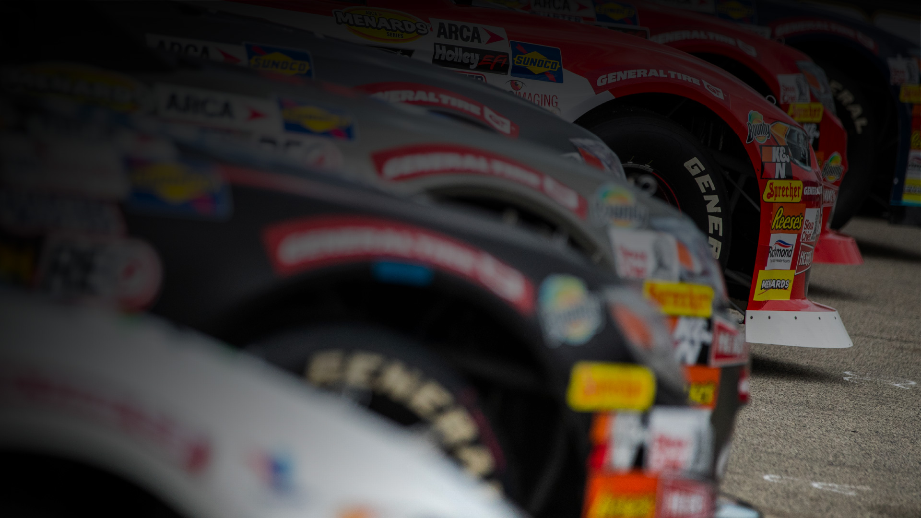
2023 BROADCAST
FOX/USA
BEN BAKER
Managing Director , Domestic Broadcasting
NASCAR

Slide 5


FOX Sports Renewal
FOX Sports to carry 14 ARCA Menards Series races on FS1 with 6 races on FS2
Distribution of ARCA Menards Series races to significantly increase
Select races to also air on FloRacing
DATE | RACE | NET | START (ET)
Sat, Feb 18 | Daytona | FS1 | 1:30 PM
Fri, Mar 10 | Phoenix | FS2 | 8:00 PM
Sat, Apr 22 | Talladega | FS1 | 12:30 PM
Sat, May 06 | Kansas | FS1 | 2:00 PM
Fri, May 26 | Charlotte | FS1 | 6:00 PM
Sat, Jun 17 | Berlin | FS1 / FloRacing | 8:00 PM
Sat, Jun 24 | Elko | FS2 / FloRacing | 9:00 PM
Fri, Jul 07 | Mid-Ohio | FS1 / FloRacing | 6:00 PM
Sat, Jul 15 | Iowa | FS2 / FloRacing | 8:00 PM
Fri, Jul 21 | Pocono | FS1 / FloRacing | 6:00 PM
Fri, Aug 04 | Michigan | FS1 / FloRacing | 6:00 PM
Fri, Aug 11 | Lucas Oil | FS1 | 6:00 PM
Fri, Aug 18 | Watkins Glen | FS1 | 6:00 PM
Sun, Aug 20 | Illinois State Fairgrounds | FS1 / FloRacing | 2:00 PM
Sun, Aug 27 | Milwaukee | FS1 | 1:00 PM
Sun, Sep 03 | DuQuion | FS2 / FloRacing | 9:00 PM
Fri, Sep 08 | Kansas 2 | FS1 | 6:00 PM
Thu, Sep 14 | Bristol | FS1 | 6:00 PM
Sat, Sep 30 | Salem | FS2 / FloRacing | 4:00 PM
Sat, Oct 07 | Toledo | FS2 / FloRacing | 4:00 PM
2023 Broadcast Plans

Slide 6



ARCA Menards Series East & West on CNBC & FloRacing
ARCA Menards Series East & West races to continue to air live on FloRacing.
Races will air on tape delay (approx. 1 week) on CNBC. NBC Sports is shifting certain sports content to CNBC which offers weekend afternoon availability.
ARCA Menards Series on MRN & SiriusXM
13 ARCA Menards Series races and 2 ARCA Menards Series West races will air live on MRN Radio platforms.
All races will also be carried live on SiriusXM in the sports channel tier.
2023 Broadcast Plans

Slide 7
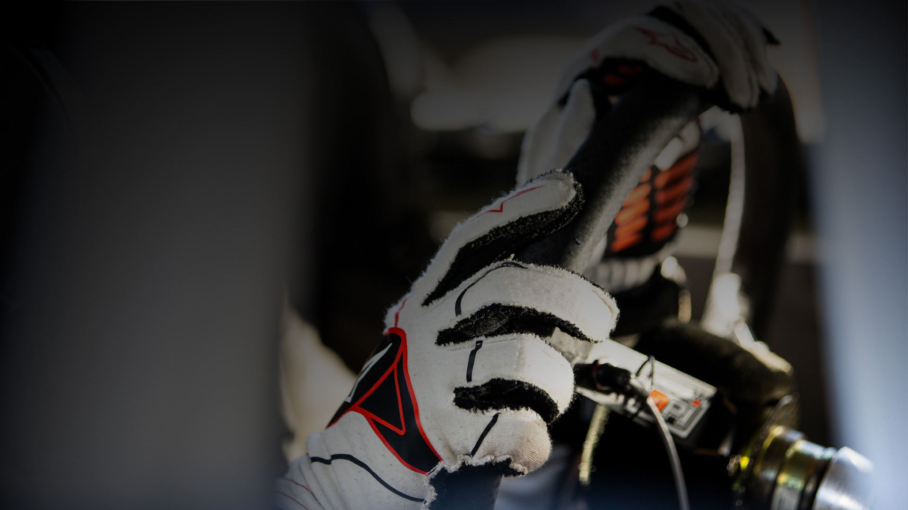
2023 BROADCAST
FLO RACING
DAN BARKER
Managing Director, Direct to Consumer
NASCAR

Slide 8
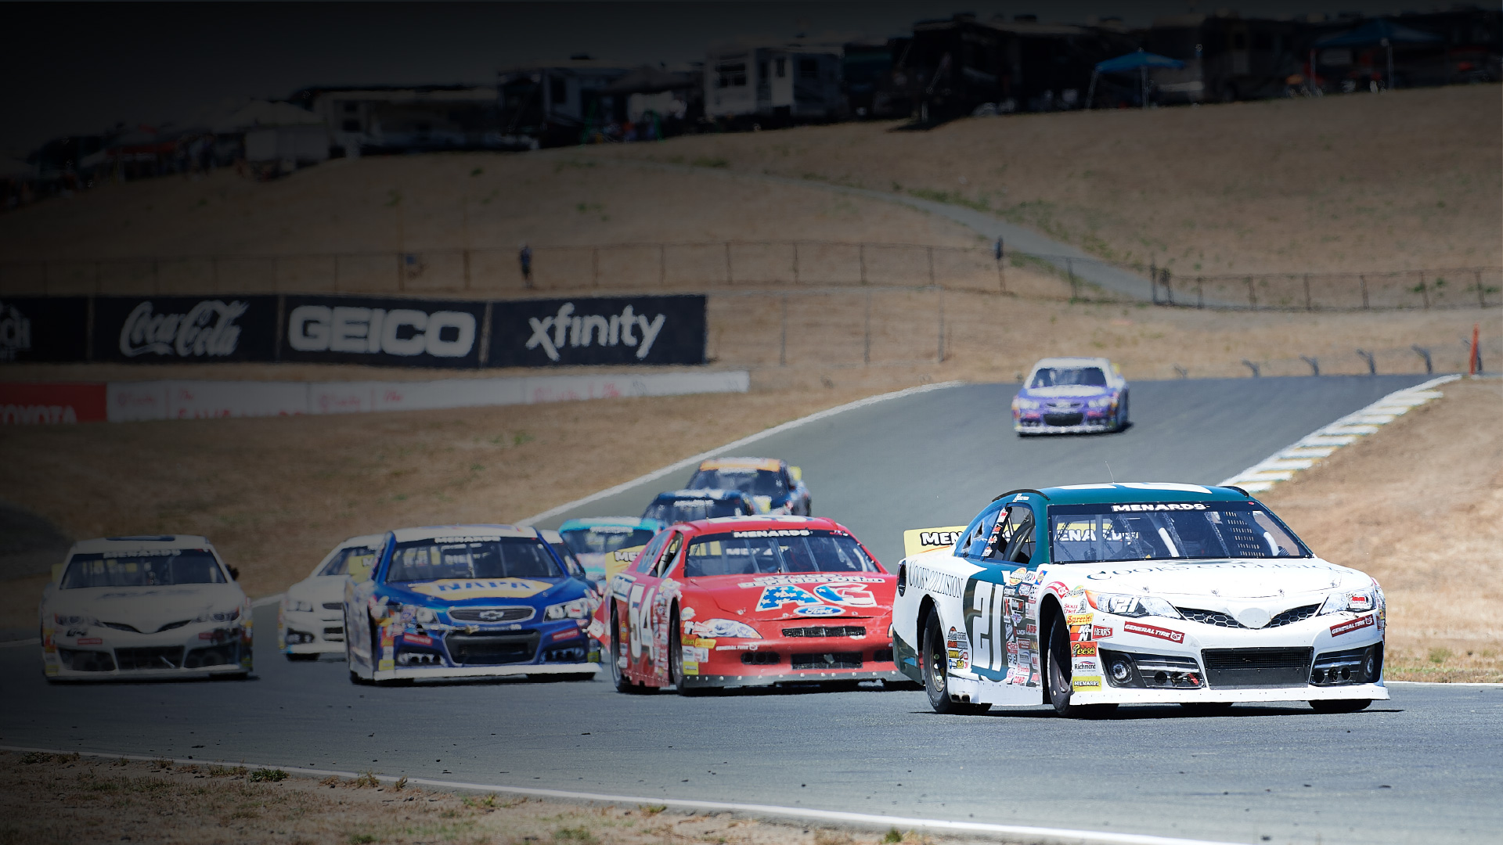
2023 LICENSING
& VIDEO POLICY
JOE KELLY
Access & Production Coordinator, Library & Licensing
NASCAR

Slide 9
TEAM/DRIVER SOCIAL CONTENT CAPTURE:
Teams with 2 cars or less – 1 video person at track for no access fee​
Teams with more than 2 cars – 2 video people at track for no access fee​
Drivers may have their own video person in addition to above for no
access fee – 1 per driver​
Footage can be used on Team/Driver social channels only for no licensing fee​
Content people must wear a vest at track and attend mandatory Zoom photo meeting week of the event​
Team/Driver rep must reach out to Licensing Support to complete paperwork before the position is approved​ (licensingsupport@nascar.com)
Free access is only for team/driver social use, sponsors must
be licensed through Licensing Support and pay fees​
Deadline to submit sponsors for content capture is one week before
the event weekend
ACCESS & ​LICENSING​
POLICY​

Slide 10
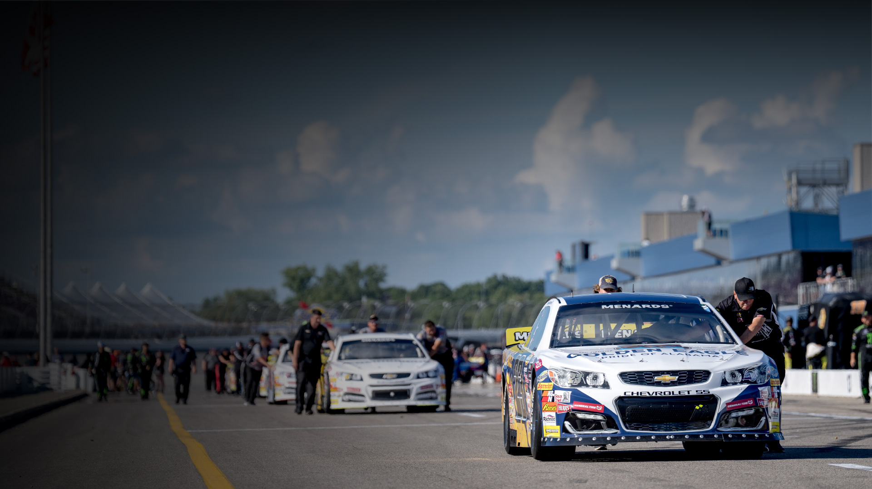
2023 COMMUNICATIONS PLAN
CHARLES KRALL
Manager of Communications
ARCA Menards Series

Slide 11
The goal of our communications plan is to create as much interest, exposure, and goodwill in the ARCA Menards Series, our races, our teams, our drivers, and our sponsors as we possibly can.​
Through coordinated efforts with all of our stakeholders, we strive to increase awareness with hardcore race fans and the casual, general sports fans in each of the markets that will host a race across the ARCA Menards Series platform in 2023.
COMMUNICATIONS
PLAN 2023

Slide 12
What is the ARCA Menards Series?​
NASCAR’s “stars of tomorrow” are racing ​
in the ARCA Menards Series today. ARCA’s tagline is “We Build Champions”.​
Drivers racing in the ARCA Menards Series are hoping to follow in the footsteps of dozens of other drivers who got their start in ARCA.​
Current number of drivers in the NASCAR National Series have competed in ARCA​
History of the ARCA Menards Series, ARCA Menards Series East & West
COMMUNICATIONS
PLAN 2023

Slide 13
ARCA Menards Series races are fan friendly, with reasonably-priced tickets that offer fans numerous opportunities throughout the season to get up close and personal with the drivers, teams, and cars. Each stand-alone short track race is preceded by a driver autograph session, many of them on the track immediately before the race. Conjunction races with the national NASCAR series often include autograph sessions in the garage area or fan zone prior to the race. ​
For those who cannot attend in person, each of the 20 ARCA Menards Series races are televised live on FS1 and FS2 while the East and West races are streamed live on Flo Racing. MRN Radio will provide live radio coverage of every conjunction race.​
COMMUNICATIONS
PLAN 2023

Slide 14
THE ARCA MENARDS SERIES WILL CONTINUE TO UTILIZE ARCARACING.COM AS THE HUB FOR ALL ARCA-RELATED NEWS, TIMING & SCORING, AND PHOTOS.
ARCA’s social channels have taken larger role in driving traffic to the website and will also be the where in-race updates, videos, and fan interaction will take place. ​
ARCA will publish pre-event “Pit Box” updates previewing each event across the platform, as well as post-race recaps and notes packages.
COMMUNICATIONS
PLAN 2023

Slide 15
ARCA media outreach will focus on unique human-interest stories, especially those that are relevant to each local race market, that do more than talk about racing.
Teams have been given access to ARCA’s media contact list and are encouraged to do their own media outreach with unique story ideas. ​
ARCA will support unique team stories through outreach assistance and/or publication on the website and social channels. ​
ARCA will produce and share tune-in graphics for each race that can be shared via driver and team social channels.
COMMUNICATIONS
PLAN 2023

Slide 16
ARCA will produce unique content with drivers at all events in 2023. That content will be used on all of ARCA’s digital channels.
Drivers will be invited to participate in periodic mid-week Zoom media availabilities throughout the season.​
Following each race, the winner will go to victory lane for interviews with our broadcast partners. Drivers finishing second through fifth, and any others selected by ARCA, will stop at a pre-determined location for their post-race broadcast obligations. This is mandatory, and they will not be released until directed by ARCA staff.​
The top three finishers in each race will participate in post-race press conferences and/or Zoom availabilities at the direction of ARCA marketing and communications staff. This is mandatory, and they will not be released until directed by ARCA staff.
COMMUNICATIONS
PLAN 2023

Slide 17
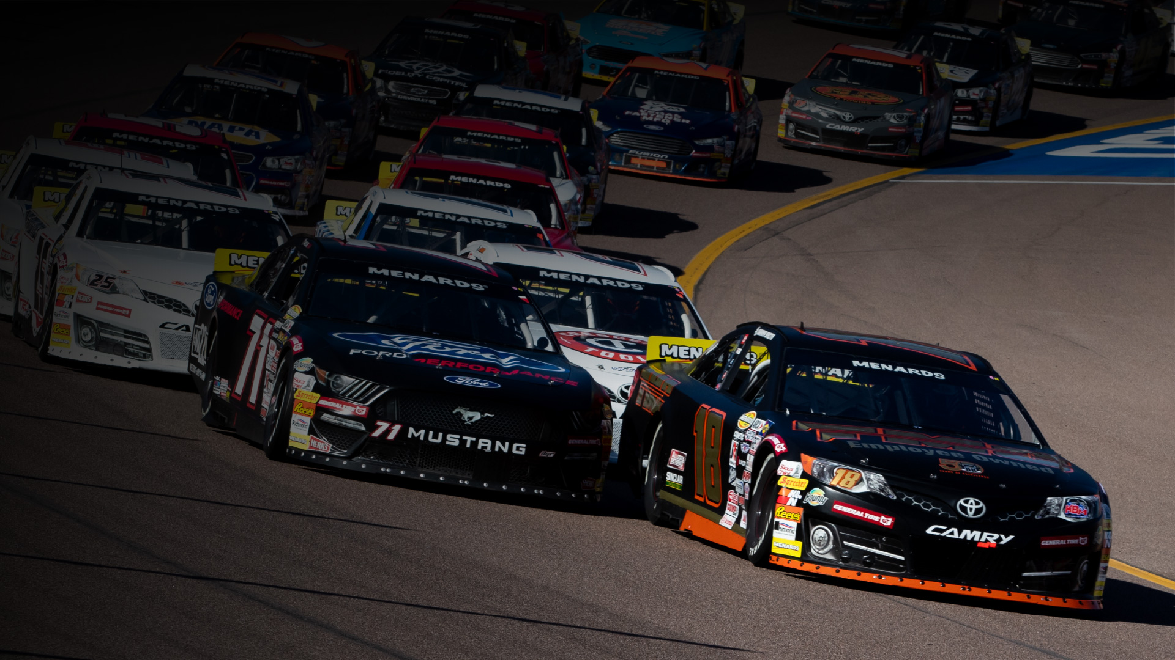
2023 PARTNERSHIP INFORMATION
Jesse Harris – Managing Director, Partnerships & Business Operations
ARCA Menards Series

Slide 18

Menards is the 3rd largest home improvement retailer in
the U.S. with over 350+ stores in 15 states.​
Menards has been a supportive of American motorsports
for over three decades.​
ARCA’s relationship with Menards began in 2009.​
They became the series entitlement partner in 2019 and
will continue to do so through 2024.​
The relationship is growing stronger each season.​
If you see a Menards representative or Vendor partner this season, please stop and thank them for supporting our platform.
ARCA / MENARDS RELATIONSHIP

Slide 19

FOUR (4) MAJOR VENDOR PARTNERS WHO
SUPPORT THE MENARDS SERIES ENTITLEMENT:
Procter & Gamble: Bounty Rookie Challenge ​
Richmond Water Heaters: Halfway leader award program​
Reese’s: Reese’s Sweet Move of the Race​
Sioux Chief: Sioux Chief “Fast-Track” (New for 2023)
ADDITIONALLY
Menards supplier / vendor partners will support a minimum of 9 ARCA Menards Series race events as title sponsors.
MAJOR ​
ARCA MENARDS SERIES VENDOR PARTNERS​

Slide 20
In addition to series support, Menards ​is also
willing to assist race teams.
Menards utilizes Forward Sports Marketing​
FSM specialty is product donation / barter​
Product must be established and already have
distribution at other major retailers
For more info on team sponsorship opportunities
with Menards through a supplier program, contact:
Jesse Harris - jaharris@arcaracing.com
MENARDS TEAM
SPONSORSHIP

Slide 21
ARCA takes pride in giving drivers experience at all aspects of
being a professional racecar driver before making the move into
a national NASCAR touring series. This includes partner meet
and greets on race day.​
Menards will invite up to 200 contractors per event during at least nine races in 2023. Guests are provided tickets to the event plus food and beverage in a hospitality area. ​
ARCA Menards Series marketing officials will ask several drivers to make an appearance at each hospitality event to do a Q&A session.​
Hospitality Q & A requests will come from
Jacob Stotz the week of the race event.
MENARDS HOSPITALITY

Slide 22
To help promote the race events in the Menards markets, ARCA Menards Series and Menards will host store appearances with
a minimum of two drivers per appearance. ​
Drivers can dress casually but should wear team apparel.
Drivers should bring pre signed hero cards.​
We attempt to schedule appearances the night before the first on-track activity. They last one hour, and generally start at
6 pm local time.
If you would like to volunteer for an appearance, please contact: Jacob Stotz - jstotz@arcaracing.com
MENARDS STORE APPEARANCES​
​

Slide 23
ON-BOARD CAMERAS ARE AVAILABLE FOR TEAMS AND/OR SPONSORS FOR THE 2023 ARCA MENARDS SERIES EVENTS SCHEDULED FOR BROADCAST ON FOX SPORTS. INCLUDING:
(1) One season long (20) race on-board camera for all FS1 and FS2 Events for 2023. $85,000 per season (15% off)​
Limited on-board camera packages are available for FOX Sports broadcasts. $5,000 per event for full on board or $2,500 per event for co-branded on-board with General Tire.
Teams will be required to enter into formal contractual agreements and payment must be received in advance of
camera installation for each event.
Teams interested in purchasing on-board camera
packages should contact :
Dan Stuart - jstuart@arcaracing.com
ON-BOARD
CAMERAS

Slide 24
For the first time ever, :30 second commercial broadcast spots are available for teams and/or sponsors for ARCA Menards Series events scheduled on FOX Sports.
Discount team prices are as follows:
(1) :30 second spot (20 race broadcast + re-airs)
for all FS1 and FS2 Events. $50,000 per season​
This is a 50%+ discount (4 spots available)
Teams will be required to enter into formal contractual agreements and payment must be received in advance. ​
Teams and/or sponsors are responsible for production and cost of TV spots. Spots will need to be built and approved by FOX standards and practices. ARCA to assist with trafficking spots.
Parties interested in purchasing :30 second spots should comtact:
Dan Stuart - jstuart@arcaracing.com
:30 TV ​SPOTS​

Slide 25
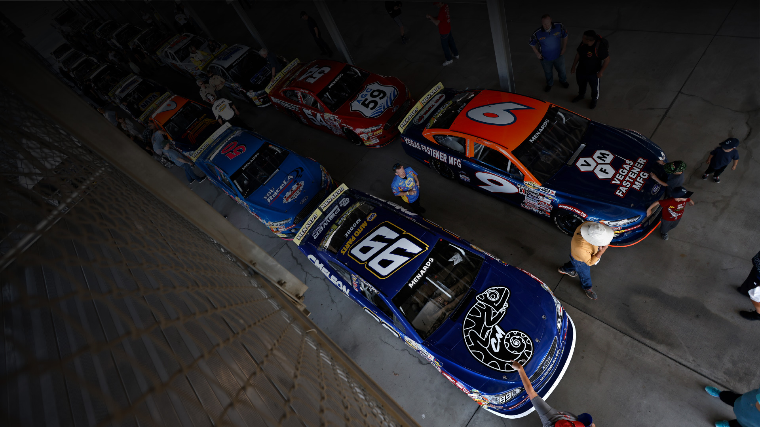
2023 PARTNERSHIP INFORMATION
JAKE STOTZ
Senior Manager Marketing Operations and Events​
ARCA Menards Series

Slide 26
The 2023 driver fire suit guide is now available
via the ARCARacing.com competitor's site.
It is also available per request via email.
Please make sure all patches are affixed to the uniform before
pre-race ceremonies. Drivers might be asked by a photographer
for a photo of them in their uniform during pre-race. ​
If you have a concern that one of the patches might fall off during the race, please be prepared post race with one of the patches as replacement. If a driver does not have one the mandatory patches on during post-race interviews, they are subject to a fine.
Patches are available in the ARCA Hauler, or email to request:
Jacob Stotz - jstotz@arcaracing.com
Note: The number of contingency patches required for awards money has been decreased. Awards will still be paid out as in previous years.
2023 FIRESUIT
GUIDE

Slide 27
THE 2023 FENDER DECAL GUIDE IS NOW AVAILABLE.
All mandatory decals must be placed on the car before the start
of practice. If a car does not have the mandatory decals on the car before practice, they are subject to loss of practice time until the decals are placed. ​
Decal packs will be distributed by SRI Performance. Please call SRI at (704) 662-6982 to request decals. They will also be available on the SRI trucks at conjunction events and on the ARCA Haulers. ​
If a decal is not available at the track, a team will be given credit
for the decal and be eligible for the award.
At all ARCA races, your team must display the AMS Flag on the hauler. This will be documented at each race for awards eligibility.
2023 FENDER
DECAL GUIDE

Slide 28
The 2023 Race Event and Year-End Awards Guide will ​
be available via the ARCARacing.com competitors’ site throughout the season.
Hard copies will also be available at the season-opening events for each series.
The book breaks down all sponsors in the series.
Payout for per race awards
Payout for end of the year awards
Whether a decal, use of product and/or uniform patch is required for eligibility to receive the award(s)
2023 AWARDS
GUIDE

Slide 29
THERE WILL BE TWO AWARDS YOU MUST
DECLARE YOURSELF FOR TO BE ELIGIBLE TO WIN:
Bounty Rookie of the Year​
Cometic Crew Chief of the Year
2023 AWARDS ​
DECLARATIONS​

Slide 30
Teams with potential sponsorship that may fall into a questionable classification must contact ARCA for prior approval, in writing. ​
Some Example Industries Include: Gambling, Political Campaigns, Political Super-Pacs, Tobacco, CBD, Firearms, Distilled Spirits.
For any team sponsor questions, please contact:
Jacob Stotz - jstotz@arcaracing.com
ARCA MAY REJECT ANY PLAN OR SPONSOR IN ITS SOLE DISCRETION, WITHOUT REFERENCE TO THESE GUIDELINES.
SPONSOR
GUIDELINES

Slide 31
THESE ASSETS HAVE BEGUN TO RETURN TO PRE-PANDEMIC LEVELS OF AVAILABILITY.
Guests Garage Passes​
Grandstand Tickets​
Suite Access​
Hospitality​
Display
Teams interested in purchasing/acquiring at-track assets
should contact Jacob Stotz - jstotz@arcaracing.com
TEAM AT
TRACK ​NEEDS​

Slide 32
You will be provided with a generic login to PhotoShelter, our photo hosting website. Please look at the available photos and email the photo number. ​
To help make it easier and quicker to receive the photos,
please list the event that each photo comes from.
Any photo request in 2023 should be made to
Jacob Stotz - jstotz@arcaracing.com
PHOTO REQUEST

Slide 33
VICTORY LANE RUN OF SHOW
Driver/Car straight to interview area (victory
lane or start/finish line) after checkered flag
Wait for instruction by ARCA official to exit vehicle
TV Interview
Radio Interview, if applicable
Track Trophy Presentation
Hat Dance
Media Availability
VICTORY LANE PROTOCOLS

Slide 34
UNOH STILL HAS AVAILABLE STUDENTS FOR
THE 2023 SEASON TO HELP ON RACE TEAMS.
If you are interested in partnering with this program, please email
Jacob Stotz - jstotz@arcaracing.com
UNOH ​STUDENT ​
PROGRAM

Slide 35

2023 TEAM
SUPPORT​
DAN STUART
Director, Partnership Marketing
ARCA Menards Series

Slide 36
ABOUT HOOKIT / KORE
Hookit has been the leader in the sponsorship analytics space since we pioneered it in early 2000s
Work with 100s of the best brands and rights holders pulling out insights from massive amounts of social media data to help make sponsorships & fan engagement more powerful
Acquired by KORE in Jan 2022, leader in sponsorship, ticketing & fan management software
Together, we have a one-of-a-kind data set and platform within sports to help management, measurement & optimization of sponsorships & fans
900+ rights holder and brand clients, tracking the entire sport ecosystem (100k athletes, 5k teams, 10k brands…)
HOOKIT ​SOCIAL MEDIA​ SUPPORT​

Slide 37
WHY SOCIAL?
It is where this generation consume sport
Billions of people, direct access and within
your power to connect
Brands care deeply about it
Massive amounts of near real-time data
available to optimize strategy
IN IT TOGETHER
Everyone on this call could and should be working together to
capture and grow the ARCA audience. Start with some best practice
Presence on all platforms
Authenticate with us to measure Stories & FB Video
Tailor your content to the platform and audience on them
HOOKIT ​SOCIAL MEDIA​ SUPPORT​

Slide 38
  Facebook likely best fit for existing audience – video is key
  Instagram should be priority - specifically short vertical video format (Reels)
  TikTok for youth audience, need content to match
  Twitter for race weekend updates, but video performs really well
  YouTube gets you onto TV and larger devices
4. Use event hashtags!
  Shorter the better
  Make sure everyone - partners, media, drivers, teams
  are all aware and using them
  Be consistent year over year
5. When promoting brands
  Mentions drive most value, then tags, hashtags & keywords … above ‘the fold’ with limited ‘competition’
  Logo ~2% of screen is sweet spot and maxes out value
HOOKIT ​SOCIAL MEDIA​ SUPPORT​

Slide 39
MOST INFORMATION DISCUSSED IN THIS MEETING
WILL BE PART OF THE TEAM PR HANDBOOK.
Also included in the book is track contacts for all events.
Media Center access for PR reps
RV Parking contact
This document will be available at ARCAracing.com
under the Competitors site.
Limited copies will also be available at track.
TEAM PR
HANDBOOK

Slide 40
HEADSHOT PHOTOS WILL BE MANDATORY FOR ALL DRIVERS AT THEIR FIRST EVENT IN 2023.
Photo sessions will be scheduled at Daytona, Phoenix, and Five Flags and all drivers must have a photo on file before they are eligible to practice. ​
Headshot photo will be taken with driver uniform. Please make
sure all mandatory uniform patches affixed to the uniform before arriving to get your photo. ​
We will be assigning times for each driver to get their photo taken. ​
Any remaining event, please have your driver take a photo in uniform in front of a solid white wall. Please email that photo to
Charles Krall - ckrall@arcaracing.com
HEADSHOT PHOTOS

Slide 41
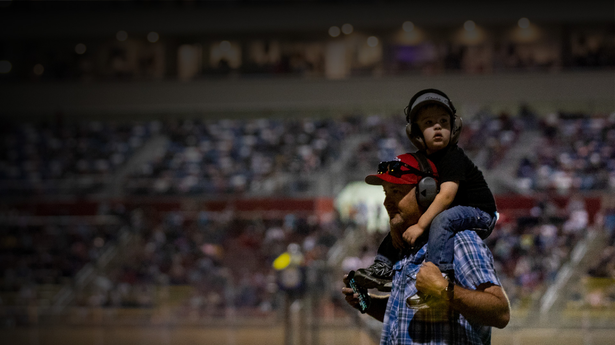
THANK YOU

